Slide 1
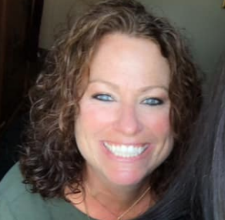
Merry StPierre Townsquare Media- Senior Marketing Consultant 23 Years of Marketing experience I have worked with businesses of all sizes from small one man operations to multiple location, multi million dollar companies. I have overseen large events, recruitment campaigns, Branding and helped many businesses in different stages from start up companies to long standing, well known businesses. Helping them with advice, connections and understanding marketing options and ideas. I train and learn everyday to stay ahead of the newest trends and options. If I don’t know about it... I know someone who does! I have been a part of many Non profit associations including United Way, KV Humane society, YMCA marketing & membership committee, HCCA Board member, Meals on Wheels and most recently the past President of the Augusta Rotary.
My success is a direct reflection of my clients success!
If they don’t succeed I don’t succeed.

